Slide 1



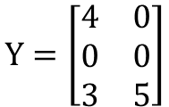






1. Prepare the data by filling unknown ratings with zero
$$Y=\left[\begin{matrix}4 & 0 \\ 0 & 0 \\ 3 & 5\end{matrix}\right]$$
$$Y^{T}=\left[\begin{matrix}4 & 0 & 3 \\ 0 & 0 & 5\end{matrix}\right]$$
User-item
Item-user
2. Perform clustering on users and items
$$\left\{user_group1, user_gruop2\right\}$$
$$\left\{Item_group1, Item_gruop2\right\}$$
This stage still has room for improvement, such as the clustering algorithm and auto-clustering methods.
User 1
User 2
Item 3
Item 1
Item 2
3. Combine the user clusters and item clusters into a "favorite transaction" set
User 1:
$$\left\{Item1\right\}$$
$$\left\{User_group2, Item1, Item_group1\right\}$$
This is how we solve the cold-start problem; when a cold-start user has a segment, we can create an item signal or a group of item signals for them.
User 2:
Cold start user
$$\left\{User_group1\right\}$$
User 2:
$$\left\{Item2\right\}$$
$$\left\{User_group1,Item2, Item_group2\right\}$$
A "favorite transaction" contains items with a score greater than or equal to 80%.

Slide 2





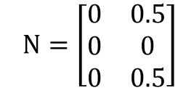

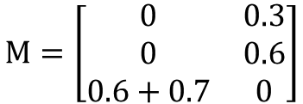








4. Mine for rules from the "favorite transaction" set using the FP-growth algorithm
1. $\left\{User_group2\right\}$
$$→\left\{Item_group2\right\}$$
Confidence = 0.5
2. $\left\{User_group2, item1\right\}$
$$→\left\{Item2\right\}$$
Confidence = 0.3
There are two popular association rule mining algorithms, Apriori and FP-growth, but Apriori is computationally expensive, so we use FP-growth instead.
3. $\left\{Item2\right\}$
$$→\left\{Item1\right\}$$
Confidence = 0.6
4. $\left\{User_group1\right\}$
$$→\left\{Item1\right\}$$
Confidence = 0.7
5. Map the resulting rules to each user
User 1:
$$\left\{User_group2, Item1, Item_group1\right\}$$
$→$Rule: 1, 2
User 2:
$$\left\{User_group1\right\}$$
Cold start user
$→$Rule: 4
User 3:
$$\left\{User_group1,Item2, Item_group2\right\}$$
$→$Rule: 1,3, 4
6. Create an Item-Signal and a Group-of-Item-Signal Matrix for each user
$$M=\left[\begin{matrix}0 & 0.3 \\ 0 & 0.6 \\ 0.6+0.7 & 0\end{matrix}\right]$$
$N=\left[\begin{matrix}0 & 0.5 \\ 0 & 0 \\ 0 & 0.5\end{matrix}\right]$
If the number of signals is greater than one, they are summed together.

Slide 3


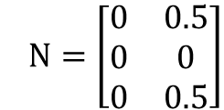


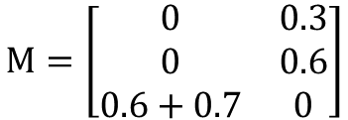

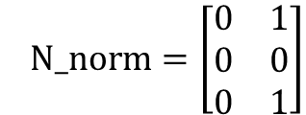

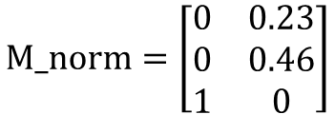

7. Normalize the signals to a range of [0,1] to prevent the gradient from exploding
$$M=\left[\begin{matrix}0 & 0.3 \\ 0 & 0.6 \\ 0.6+0.7 & 0\end{matrix}\right]$$
$N=\left[\begin{matrix}0 & 0.5 \\ 0 & 0 \\ 0 & 0.5\end{matrix}\right]$
$$M_norm=\left[\begin{matrix}0 & 0.23 \\ 0 & 0.46 \\ 1 & 0\end{matrix}\right]$$
$N_norm=\left[\begin{matrix}0 & 1 \\ 0 & 0 \\ 0 & 1\end{matrix}\right]$
8. Formulate a new loss function
$$\sum{{\left(r_{ui}−(μ+b_{i}+b_{u}+p_{u}^{T}q_{i}+α_{u}∙m_{ui}+β_{u}∙n_{ui})\right)}^{2}−λ\sum{Reg\left(θ\right)}}$$
9. Solve for all parameters using gradient descent.
$$q_{i}←q_{i}+η(e_{ui}∙p_{u}−λq_{i})$$
$$μ ←μ+η(e_{ui})$$
$$α_{u}←α_{u}+η(e_{ui}∙m_{u}−λα_{u})$$
$$p_{u}←p_{u}+η(e_{ui}∙q_{i}−λp_{u})$$
$$b_{i}←b_{i}+η(e_{ui}−λb_{i})$$
$$β_{u}←β_{u}+η(e_{ui}∙n_{u}−λβ_{u})$$
$$b_{u}←b_{u}+η(e_{ui}−λb_{u})$$
10. Predict the final prediction.
$${\hat{r}}_{ui}=μ+b_{i}+b_{u}+p_{u}^{T}q_{i}+α_{u}∙m_{ui}+β_{u}∙n_{ui}$$

Slide 4
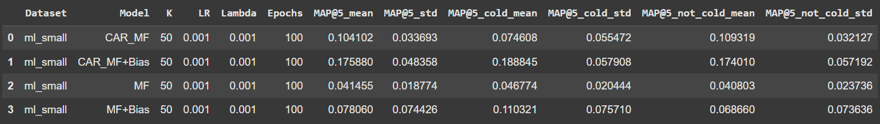
Movielen-small: Epochs=100, Learning rate=0.001, lambda=0.001,K=50,batch_size=512
Solver: ADAM

